Slide 1

아름다운코딩 with 프로세싱.py
Python Env. and
Pycharm Installation

Slide 2
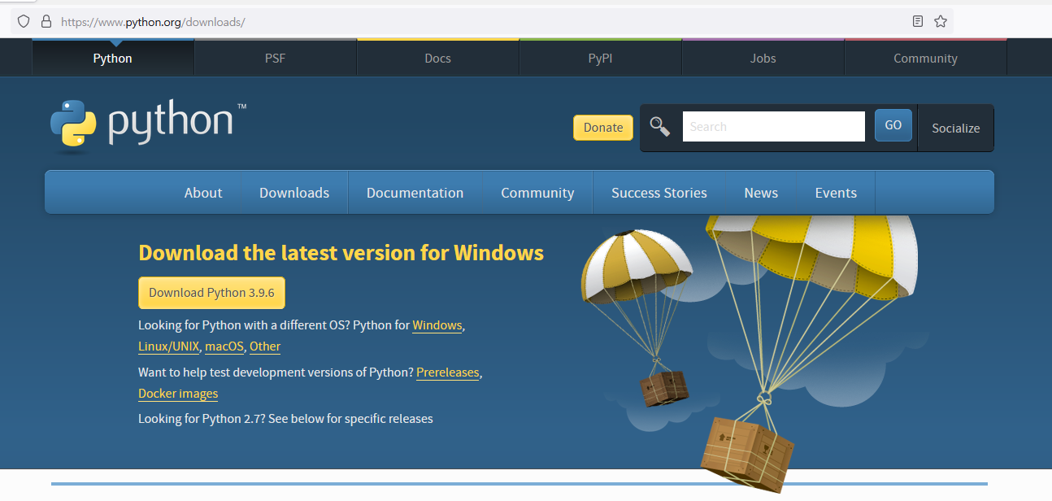
Python Environment Installation
https://www.python.org/downloads/
참고문헌: https://www.python.org/downloads/

Slide 3
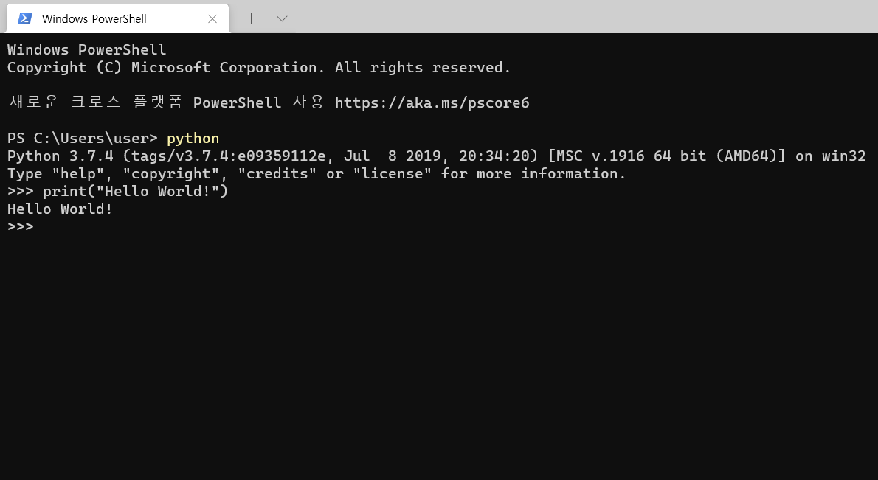
Hello World in REPL (Read, Evaluate, Print, Loop)
참고문헌: https://docs.python.org/3/tutorial/interpreter.html

Slide 4
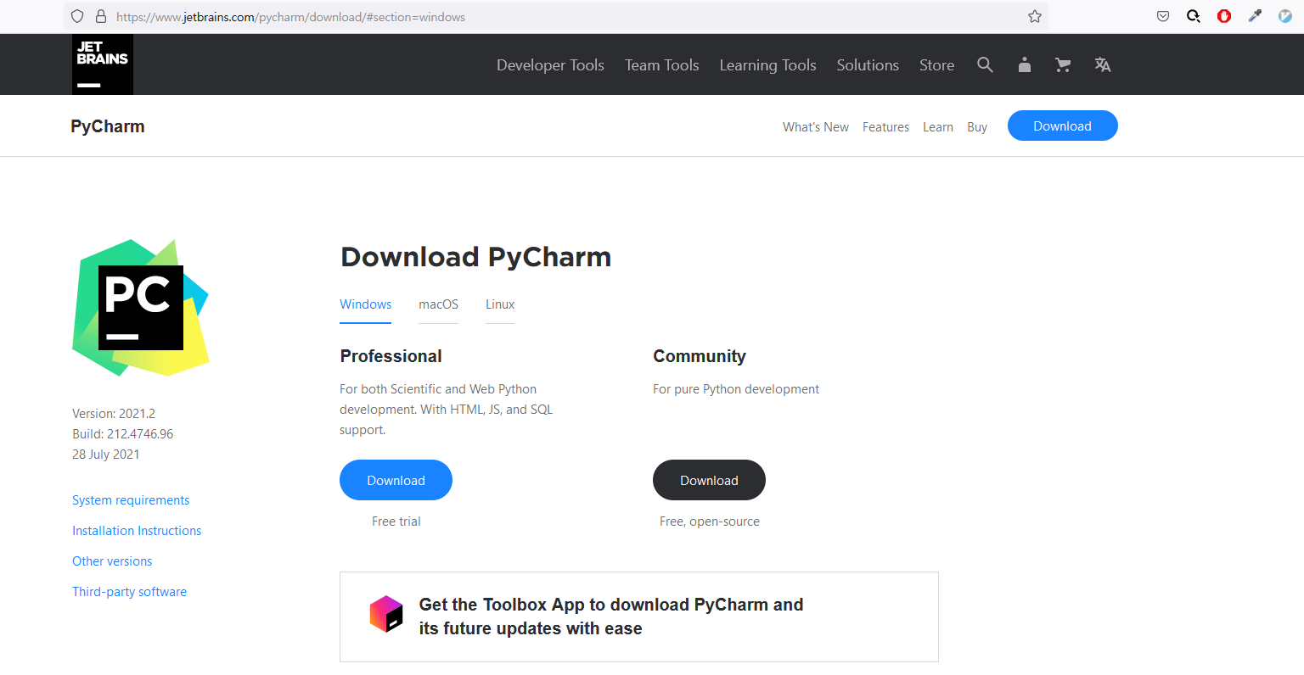
Pycharm Installation
https://www.jetbrains.com/pycharm/download/
참고문헌: https://www.jetbrains.com/pycharm/download

Slide 5
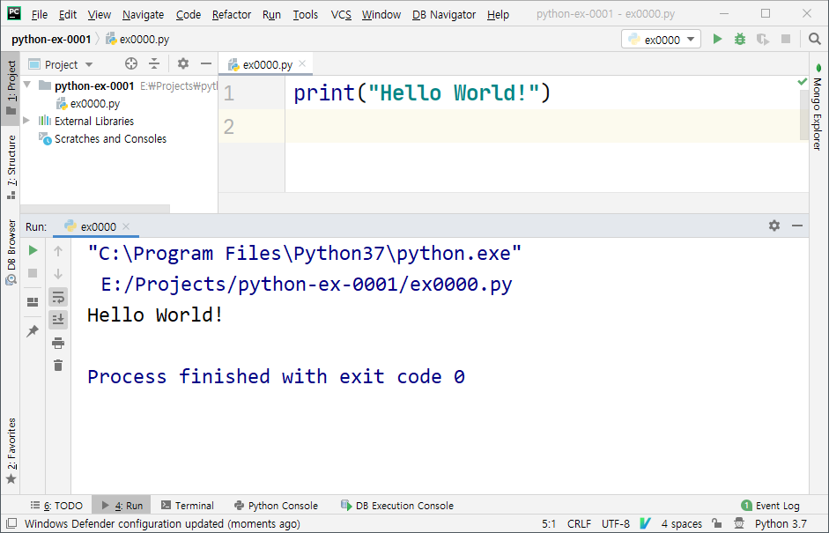
Hello World in Pycharm

